Slide 1
Preventing Opioid Misuse and Overdose
Texas Targeted Opioid Response
PRESENTER NAME

Slide 2
Presenting Organization
Texas Targeted Opioid Response
PRESENTED BY

Slide 3
Agenda
Opioid Crisis in Texas
What are opioids?
What are the risks?
What is fentanyl?
Reasons to Protect Your Health
Actions You Can Take

Slide 4
“Nearly one in six Texas students in grades 7-12 has taken prescription drugs without a doctor’s prescription.”
- PPRI, Texas School Survey of Drug and Alcohol Use, 2022.

Slide 5
Opioid Crisis in Texas
01

Slide 6
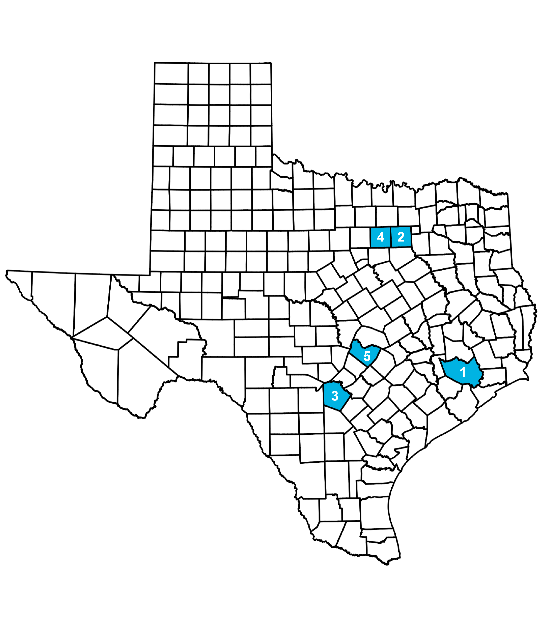
One in four Texans has experienced an opioid overdose (also referred to as a poisoning) or knows someone who has.
The top five counties in Texas with the highest counts of opioid overdose deaths as of 2022 are:
Harris County
Dallas County
Bexar County
Tarrant County
Travis County
Nearly one in six Texas students in grades 7-12 has taken prescription drugs without a doctor’s prescription, according to the Texas Health and Human Services Commission (HHSC).
In 2020, nearly 3,721 Texans died from drug overdoses, making it one of the leading causes of injury-related deaths in Texas, according to the Texas Department of State Health Services. Of those deaths, more than 50% involved a prescription or illicit opioid. Fentanyl is the leading cause of all opioid overdose deaths.

Slide 7
In 2022, Texas students in grades 7-12 reported using the following substances in the past 30 days:
SUBSTANCE USE AMONG TEXAS YOUTH
Alcohol (23%)
Illicit substances (11%)
Marijuana (10%)
Prescription drugs (5%)
Five Texans die every day, on average, from an accidental fentanyl overdose, according to Texas HHSC.

Slide 8
Regional Data
REGION NAME
You can present regional data specific to your organization's area here.
See Texas Department of State Health Services health data: https://healthdata.dshs.texas.gov/dashboards/drugs-and-alcohol/opioids/
Titles and subtitles can be changed

Slide 9
What are opioids?
02

Slide 10
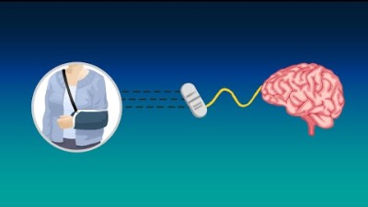
See How Prescription Opioids Work
Notes:
Video Link: https://www.youtube.com/watch?v=2w0zT1oCPVI&t=2s

Slide 11
Prescription opioids are a class of powerful pain management medications.
Prescribed to help with pain from:
A serious injury
Surgery
Wisdom tooth extraction
Cancer and more
Some examples of brand names include:
Ultram
Tylenol with Codeine
Percocet
Vicodin
OxyContin

Slide 12
What are the risks?
03

Slide 13
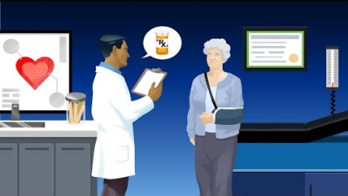
Learn the Risks of Opioid Misuse
Notes:
Video Link: https://www.youtube.com/watch?v=is9I_BsjO_U

Slide 14
Your body can become dependent on prescription opioids after just seven days, potentially setting you on a path toward addiction.
Your body and brain quickly get used to the medication. As a result:
The prescribed amount becomes less and less effective.
You would need more to manage the pain, which increases the risk of misuse and overdose.
Look for signs of withdrawal after physical dependence, such as:
Insomnia
Anxiety
Nausea
Muscle aches
Restlessness

Slide 15
Opioids are powerful medications for people with severe pain, but misusing them can be dangerous or even deadly.
Misuse is taking opioids any way other than what is prescribed by a doctor. Examples of misuse include:
Taking more than prescribed
Taking them without a prescription
Any non-medical use
Taking more than necessary can lead to dangerous side effects, including:
Oversedation
Slowed breathing
Overdose
Death

Slide 16
What is fentanyl?
04

Slide 17
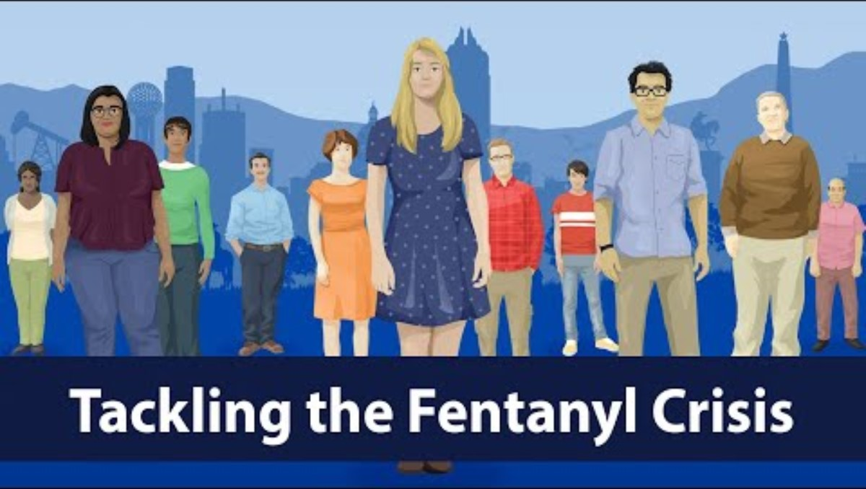
Together, Texans Are Tackling the Fentanyl Crisis
Notes:
Video Link: https://youtu.be/AR7NuBetJJg?si=Cle-rmD9wmTgzZik

Slide 18
Fentanyl, a powerful opioid, takes the lives of Texans every day.
Fentanyl is an opioid 50 times stronger than heroin. It’s safe when taken as prescribed by a doctor to treat severe pain. However, illegally made fentanyl is often mixed into counterfeit pills. Even in small doses, fentanyl can cause a life-threatening overdose. It may be added to substances with or without a person’s knowledge.
Counterfeit (fake) pills can be made to look like pills that come from a pharmacy, such as:
Oxycodone
Vicodin
Percocet
Xanax
Adderall
Fentanyl can also be added to other illegal substances, such as:
Heroin
Cocaine
Methamphetamine MDMA (also known as “ecstasy” or “Molly”)
To reduce your risk, talk with an adult you trust about the dangers of accidental fentanyl overdose and only take pills prescribed to you by a doctor. Carry naloxone to save a life in the event of an overdose.

Slide 19
Learn the signs of an overdose.
Overdose can happen when a person:
Intentionally or unintentionally takes too much of an opioid.
Mixes opioids with other drugs or alcohol at a level that is toxic to the body.
Knowingly or unknowingly takes a counterfeit prescription pill that contains fentanyl.
Signs of an overdose:
Small, constricted “pinpoint pupils”.
Face is extremely pale or feels clammy to the touch.
Body goes limp.
Fingernails or lips have a purple or blue color.
Vomiting or making gurgling noises.
Cannot be awakened or unable to speak.
Breathing or heartbeat slows or stops.
For people with lighter skin, the skin may turn blue or purple. For people with darker skin, the skin may turn gray or ashen.

Slide 20
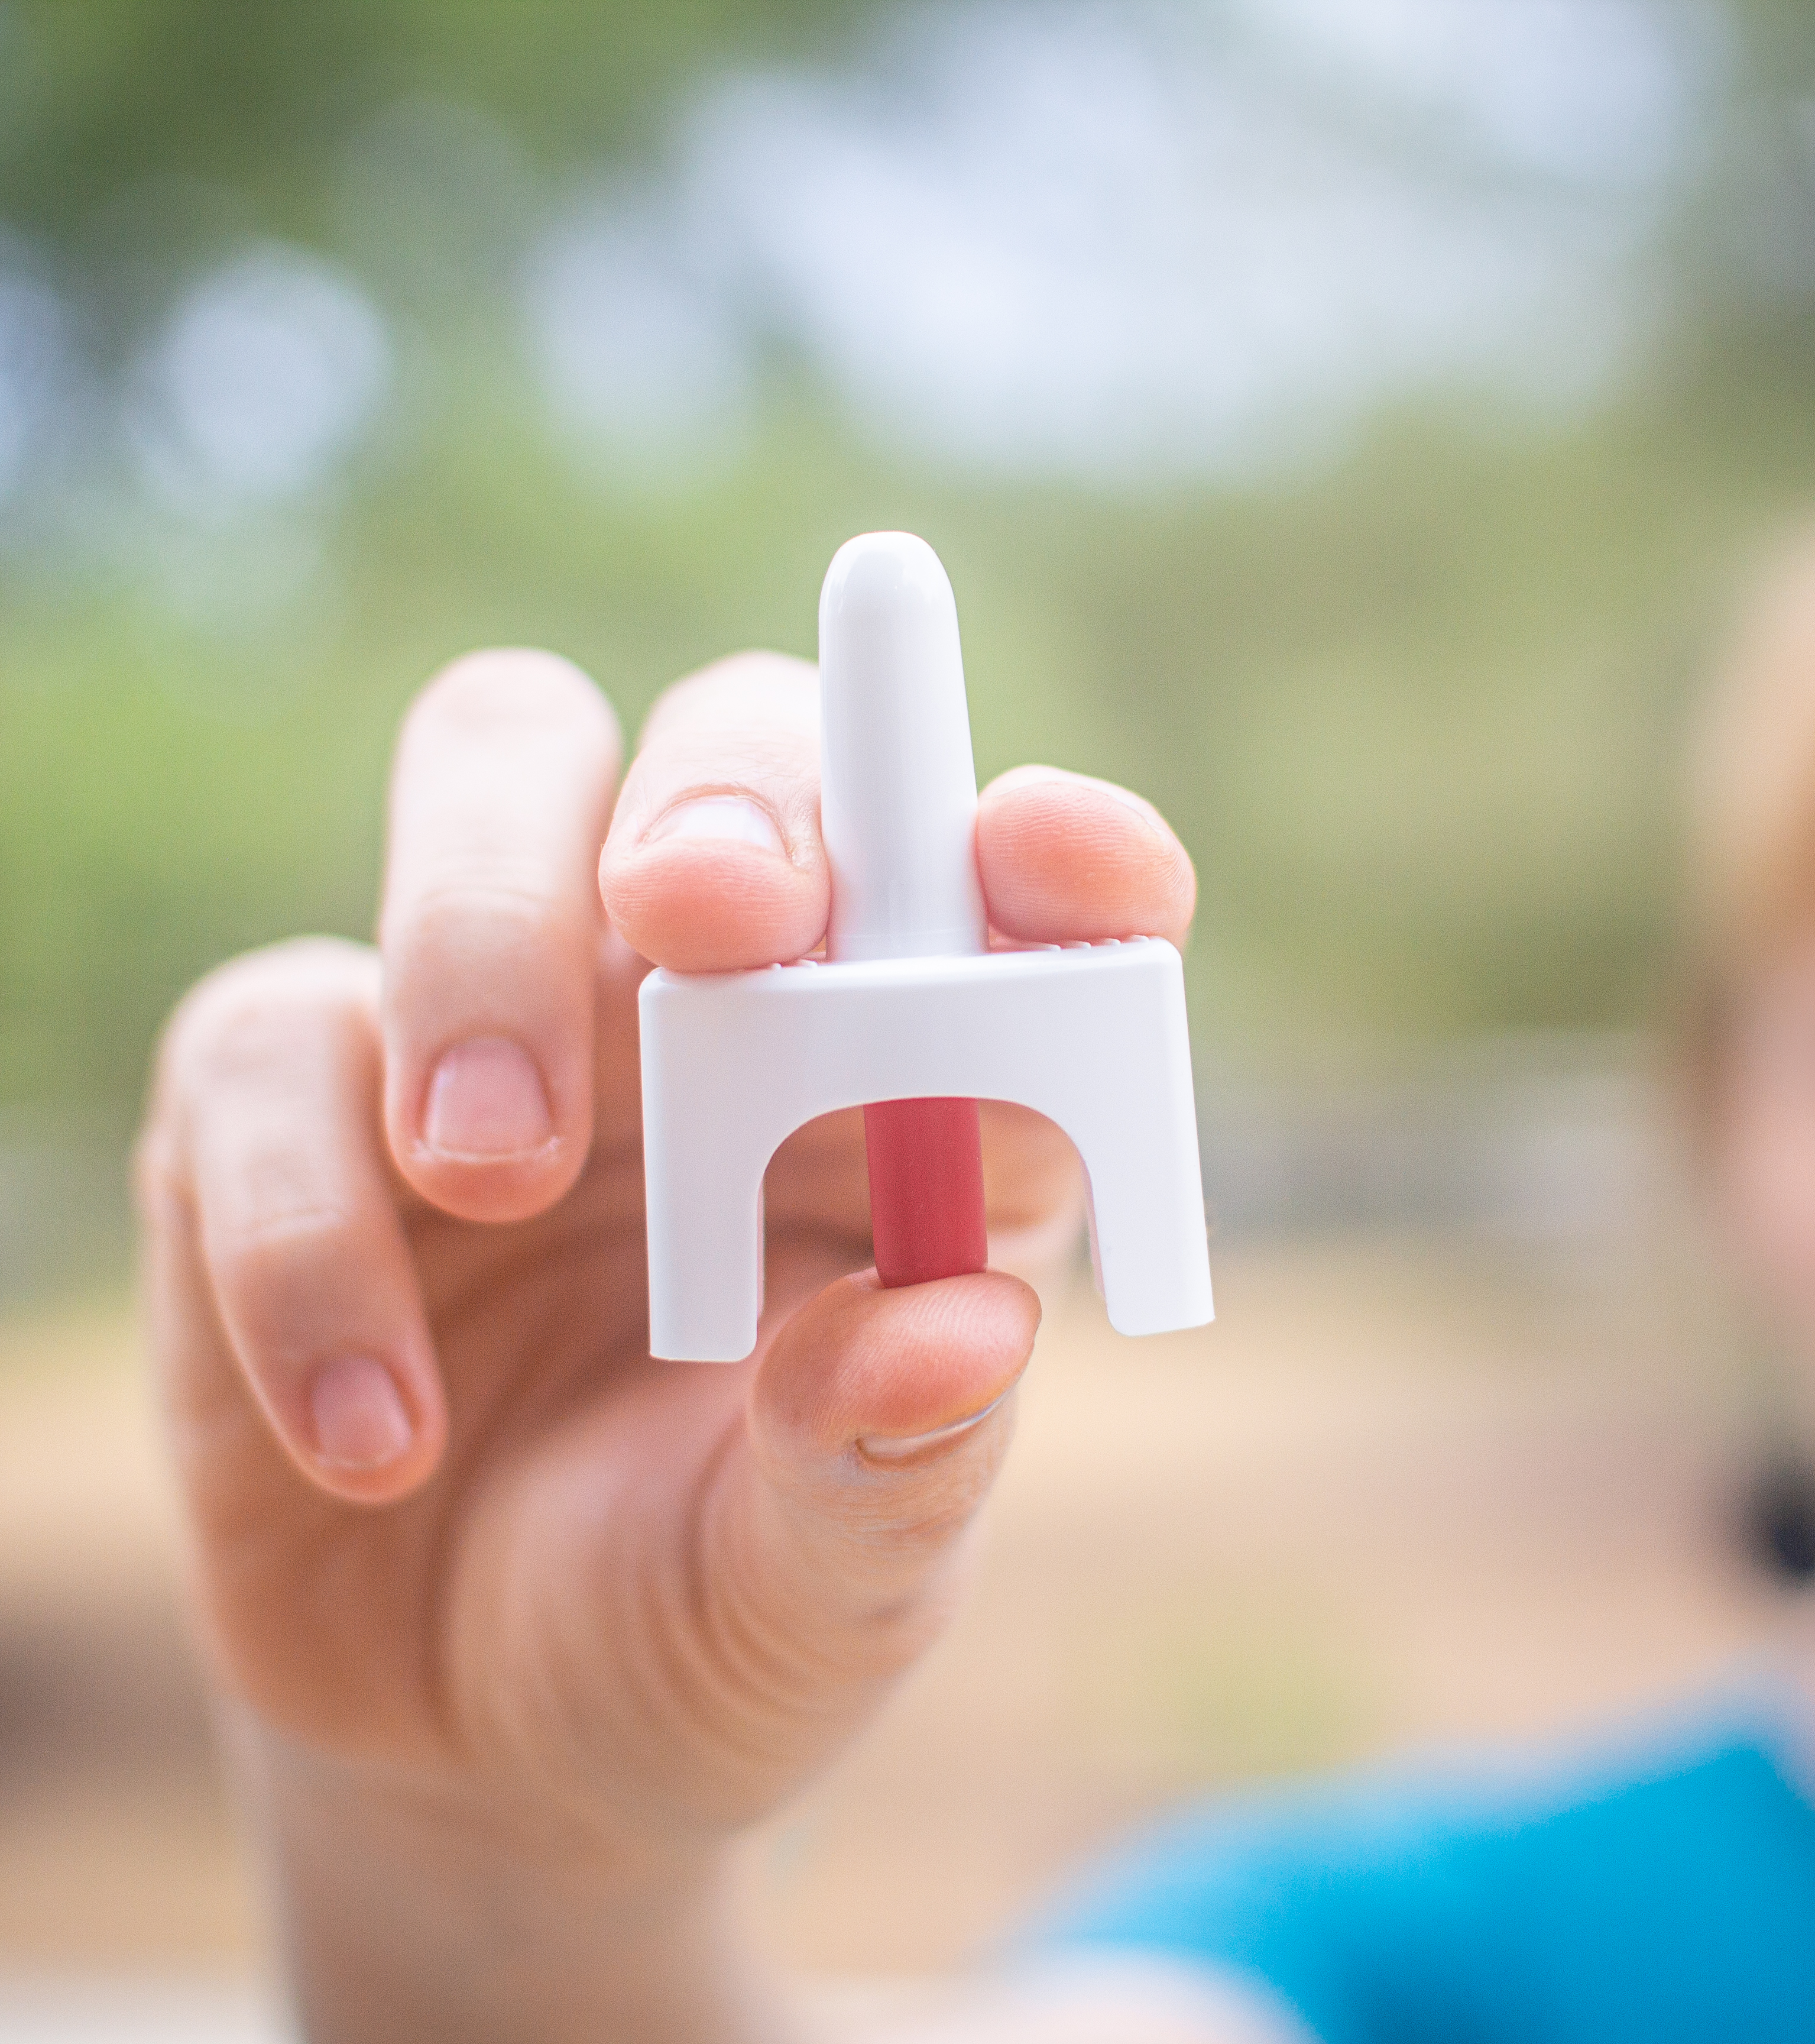
How to respond to an overdose
Call 911 right away.
Try to wake the person up.
Tilt the person’s head back and give naloxone, if available.
Begin rescue breathing or CPR.
Turn the person on their side to prevent choking.
Stay with the person until emergency services arrive.

Slide 21
Reasons to Protect Your Health
05

Slide 22

Reasons to Protect Your Health - 1
Risk of Addiction and Overdose
Drugs and alcohol change parts of your brain that impact how you think and act.
The more you use them, the harder it can be to stop, even if you want to.
Opioids affect the part of the brain that controls breathing. If someone takes too much, it can slow or stop their breathing and cause death.
Future Plans
Don’t let drug and alcohol use change or control your plans for the future.

Slide 23
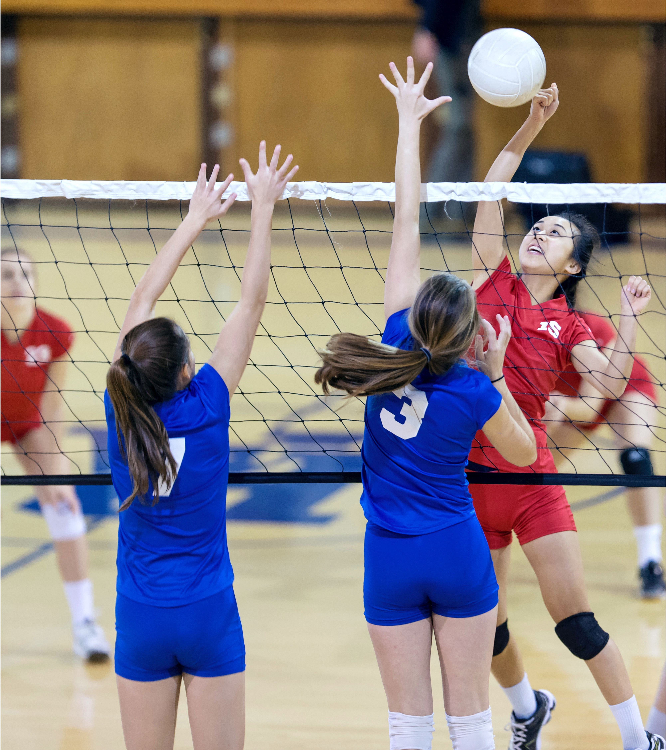
Reasons to Protect Your Health - 2
Activities and Hobbies
Participating in sports, music, hobbies or other activities can help you build friendships, stay in shape, get into college, receive scholarships and have fun.
Expense
Drugs and alcohol are not just illegal for people your age, they’re expensive.
They cost money you could be saving or spending on other things you want, need or enjoy.

Slide 24
Actions You Can Take
06

Slide 25

Lead by Example
If you are prescribed opioids by a doctor:
Only take your medication exactly as prescribed.
Never increase, cut back or stop taking your medication before talking to your doctor.
Keep your medications in a place where children and other family members cannot access them.
Only take pills prescribed to you. If they didn’t come from your doctor or pharmacist, you can’t be sure they’re safe.

Slide 26
Lead by Example - 1
Having naloxone on hand to reverse bad reactions or accidental ingestion can save someone’s life.
Naloxone blocks the effects of opioids and rapidly reverses an overdose.
Naloxone works by helping someone who is unresponsive to breathe normally again.
Naloxone has no effect if opioids are not present in a person’s system.
Naloxone is available for purchase at most Texas pharmacies without a prescription. It’s also available for free from NaloxoneTexas.com.

Slide 27
Lead by Example - 2
Explore new ways of dealing with stress.
Music, reading, writing, art, painting, sewing and cooking are good hobbies.
Get outdoors, spend time in nature, walk or exercise.
Talk with friends you trust or just be by yourself, disconnected from social media.
Care for plants, declutter or tidy up.
Pray, meditate or make wellness playlists.

Slide 28
Lead by Example - 3
Make your own personal commitment not to misuse opioids.
Talk to your friends and encourage them not to misuse opioids.
You can treat it like any other conversation you’d have with them.
Further educate yourself about prescription opioids and accidental fentanyl overdose:
TxOpioidResponse.org

Slide 29

Lead by Example - 4
Find someone you can talk to.
Leaning on adults you trust can help you navigate situations where:
You feel tempted or pressured to misuse opioids.
You are struggling with opioid misuse.
Check in on yourself.
We can’t always control the stress that comes into our lives, but we can get help to manage it. Find resources to help you cope at hhs.texas.gov/check-in.

Slide 30
You respect yourself and want to make decisions that are best for you.
Trust yourself and your choice not to use drugs or alcohol.
PRESENTER CREDENTIALS AND CONTACT INFO

